Slide 1
SECURE DATA HIDING IN IMAGES USING STEGANOGRAPHY
CAPSTONE PROJECT
Presented By
Student Name : J.KARUNAKAR
College Name & Department : KU college of engineering and technology & Information Technology

Slide 2
OUTLINE
Problem Statement
Technology used
Wow factor
End users
Result
Conclusion
Git-hub Link
Future scope

Slide 3
Problem Statement
In the digital age, ensuring the confidentiality of sensitive information is critical. Traditional encryption methods, while effective, often raise suspicion when used to secure data during transmission. Steganography offers an alternative by embedding hidden data within innocent-looking files, such as images, making detection more difficult. However, securing this hidden data against unauthorized access and maintaining the image's quality pose significant challenges. This project focuses on improving the security of data hiding techniques in images using steganography, ensuring both robustness and imperceptibility. The goal is to develop a method that can securely and efficiently embed information while preventing detection and maintaining the integrity of the image.

Slide 4
Technology used
Steganography Algorithms (e.g., Least Significant Bit, Discrete Cosine Transform, Wavelet Transform)
Python Libraries (Pillow, OpenCV)
Encryption Techniques (AES, RSA)
MATLAB (Image Processing Toolbox)
System (Windows)
Image Formats (JPG)

Slide 5
Wow factors
Dual-layer security by combining encryption with steganography for enhanced protection.
Resistance to compression ensures hidden data remains intact even after image compression.
Large data capacity hidden in a small image without noticeable quality loss.
Invisible data that cannot be detected by the human eye, even with substantial amounts of hidden data.
Resistant to detection tools like StegExpose and StegDetect, enhancing security.
Real-time embedding and extraction via an interactive interface for user convenience.
Watermarking capability for protecting digital content and intellectual property.
Adaptive algorithms that dynamically adjust to different image types for efficient hiding.
Expansion to multimedia: Hiding data in not just images but also audio and video files.
AI-powered resistance to machine learning-based steganography detection methods.

Slide 6
End users
Individuals: People who want to protect their personal information and send it securely.
Government & Military: Agencies needing secure communication for sensitive data.
Businesses: Companies that need to protect confidential data or trade secrets.
Digital Creators: Artists and photographers who want to watermark their work to protect their copyright.
Cybersecurity Experts: Professionals who monitor and secure data, or use steganography for secure storage.
Journalists & Whistleblowers: People needing to share sensitive information safely.
Healthcare & Legal Professionals: Doctors and lawyers who need to secure patient or client data.
Banks & Financial Institutions: Organizations handling sensitive financial transactions or customer information.

Slide 7
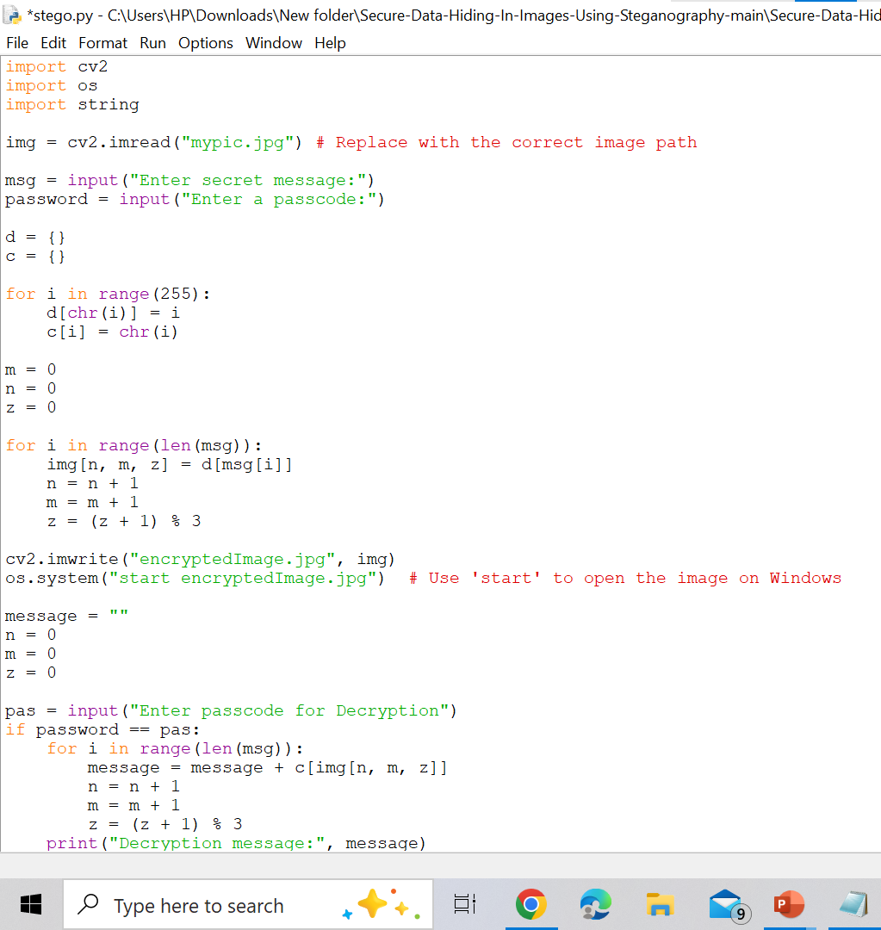
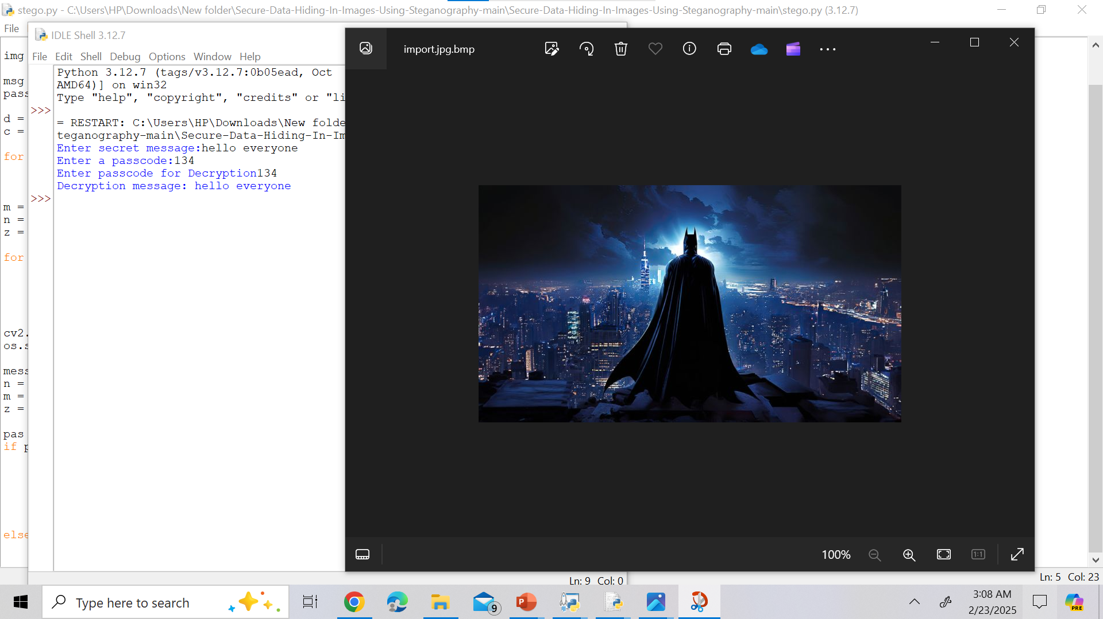
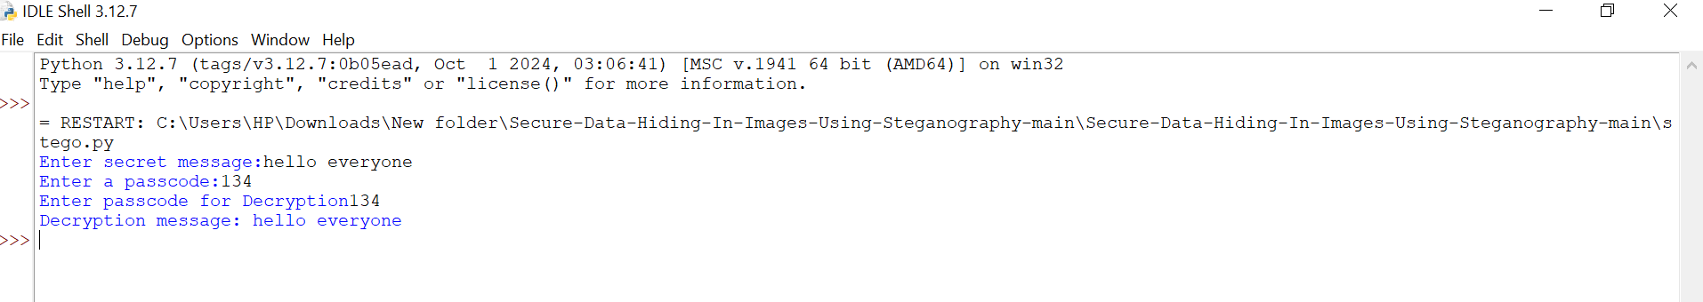
Results
)

Slide 8
Conclusion
In conclusion, this project on Secure Data Hiding in Images Using Steganography effectively solves the problem of securely transmitting sensitive information without detection. By embedding data in images using advanced steganographic techniques, we ensure confidential data remains hidden and undetectable. Combining encryption with steganography adds an extra layer of protection, making the hidden data unreadable if detected. The system provides a high data capacity without visible quality loss and resists compression. This project caters to a wide range of users, from individuals to businesses and government agencies. It offers real-time embedding and extraction, making it practical and user-friendly. With robust resistance to detection tools and advanced algorithms, the system ensures data privacy and security. Overall, it showcases how steganography can be a powerful and reliable tool for securing sensitive data. This project addresses current needs for secure communication in a digital age.

Slide 9
GitHub Link
https://github.com/karna9347/myproject-aicte.git

Slide 10
Future scope(optional)
The future scope of this project involves expanding its capabilities beyond just image files to include audio, video, and text files, providing a more versatile solution for secure data hiding across different media formats. To stay ahead of evolving threats, future improvements can focus on enhancing resistance to AI-based detection and advanced steganalysis tools, making the system more robust. Integrating the technology with real-time communication platforms could allow for secure instant messaging without the risk of data interception. Additionally, implementing data integrity checks would ensure that hidden data remains unaltered during transmission. Blockchain integration could further enhance security by offering immutable records for stored data. The system could also be adapted for use in cloud storage, providing protection against unauthorized access to sensitive files. Developing user-friendly mobile and web applications would make the technology more accessible to non-technical users, while the use of AI algorithms could allow for dynamic adjustment of the data embedding process based on the media type, improving efficiency and stealth. Finally, improving the scalability of the system would allow it to handle larger datasets and more complex use cases, making it an even more powerful tool for data security.

Slide 11
THANK YOU

